Slide 1
SUBJECT NAME LECTURE COMPANION
SEMESTER:
PREPARED BY:

Slide 2
Control Structure
Branching
Looping
Conditional
Unconditional
while
do…while
simple for loop
Nested for loop
Simple if
if…else
Nested if…else
if…else…if ladder
switch
goto
break
continue

Slide 3
Syntax : Simple if , else… if , nested if…else, if..else…if Ladder
Simple if Statement
If..else Statement
Nested If..else
If..else..if Ladder
if(condition)
{
Block Statements;
}
statement-X;
if(condition)
{
TRUE-Block
Statements;
}
else
{
FALSE-Block
Statements;
}
statement-X;
if(condition1)
{
if(condition2)
{
Block-1 statements;
}
else
{
Block-2 statements;
}
}
else
{
Block-3 statements;
}
Statement-X;
if(condition1)
{
Block-1 statements;
}
else if(condition2)
{
Block-2 statements;
}
else if(condition3)
{
Block-3 statements;
}
.
.
else if(condition N)
{
Block-N statements;
}
else
{
Default statement;
}
Statement-X;

Slide 4
Flowcharts : Simple if , else… if , nested if…else, if..else…if Ladder
Nested If..else
Simple if Statement
If..else Statement
FALSE
Condition-1
TRUE
Conditions
TRUE
FALSE
Conditions
TRUE
FALSE
FALSE
TRUE
Condition-2
Block Statements
FALSE Block Statements
TRUE Block Statements
Block-3 Statements
Block-2 Statements
Block-1 Statements
Statement-X
Statement-X
Statement-X

Slide 5
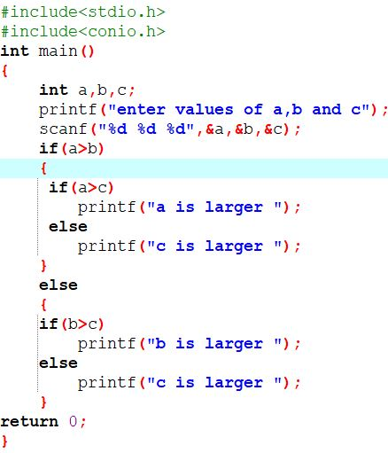
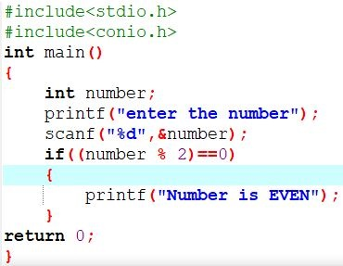
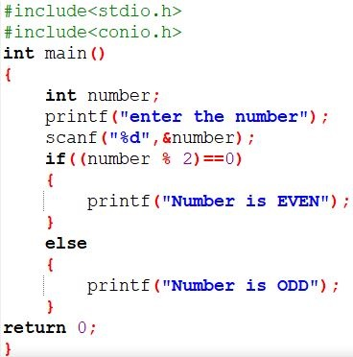


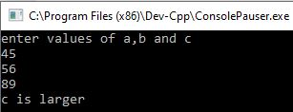
Examples : Simple if , else… if , nested if…else, if..else…if Ladder
Nested If..else
Simple if Statement
If..else Statement
Let us Enter Value : 50
Let us Enter Value : 55
Let us Enter Values : 45, 56 and 89

Slide 6
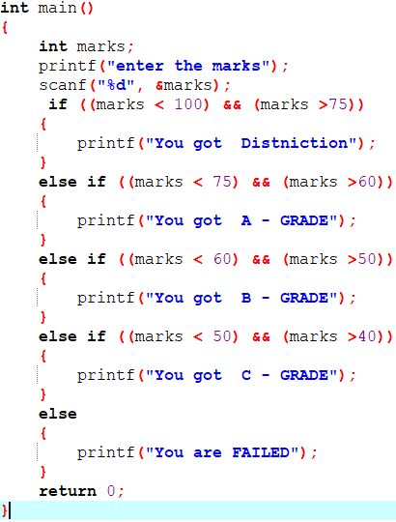

if…else…if ladder
Example
Flowchart
Condition-1
TRUE
FALSE
Block-1 Statements
Condition-2
TRUE
FALSE
Block-2 Statements
Condition-N
TRUE
FALSE
Block-N Statements
Default Statements
Let us Enter Marks : 89
Statement-X

